Slide 1


SMART INDIA HACKATHON 2024
TITLE PAGE
Problem Statement ID : SIH1654
Title- Determining expert relevance with respect to interview board subject and candidates’ area of expertise
Theme- Smart Automation
PS Category- Software
Team ID-
Team Name: Data Dazzlers

Slide 2

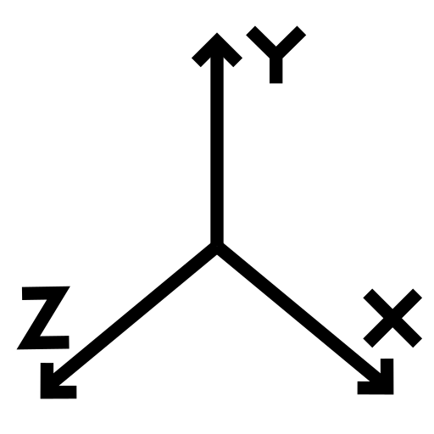



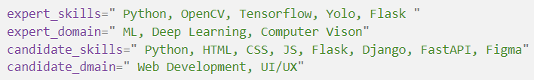

Embedding Based Summary and Similarity search of professional skills and domain for Profile Matching
Data Dazzlers
Our solution has 2 major components: Generating Profile Embeddings, and Finding Similarity Score.
Generating Profile Embeddings
Professionals provides docs and links of professional work (e.g.: Resume, CV, github)
A LLM processes the data and returns the skills and related domain of work and experience
An Embedding model generated embeddings for the retrieved skills and domain and experience
Finally the embeddings, skills, domain, experience is saved to a database
Finding Similarity Score
Retrieve both Skills and Domain Embedding for both candidate and expert.
[ .. ..]
Calculate Cosine Similarity for both skills and domain embedding for both candidate and expert to get final score
Similarity Score
[ .. ..]
Consider this example
Final Similarity Score:
0.4*(0.235)+0.6*(0.125)=0.169
where 0.4 and 0.6 are hyper -parameters.
Here similarity score of expert and candidate is very less (0.169), which shows that there is very less similarity between the two, which is correct as expert is ML Engineer and candidate is Full Stack Dev.
We will generate embedding for all 4 strings above and then calculate the cosine similarity which gives following result.

Slide 3
Calculation of Relevancy Score for Expert Candidate Pair
Data Dazzlers
Definition: InfoSource, for this presentation ‘InfoSource’ refers to various sources of information from which we can get an idea about person's professional works. e.g. Resume, CV, github , Research Work, Google Scholar Profile etc.
For every individual we will collect all relevant InfoSources.
It is not necessary that everyone will have same no. of InfoSources.
For all experts we will generate Profile Embeddings for all of their InfoSources and save it to database. (this needs to be done once, until we need to add more experts)
For a given candidate we generate Profile Embeddings and calculate relevancy score for all candidate expert pair.
Consider this example to understand Relevancy Score calculation:
Expert has following InfoSources: Resume, CV, Google Scholar Profile.
Candidate has Following InfoSources: Resume, github.
s
**This arrow symbolizes the calculation of similarity score between 2 InfoSource embeddings, where ‘s’ is the computed score.
Resume
CV
Google Scholar Profile
Relevancy Score:
mean(max(0.58,0.48,0.25)+ max(0.38,0.68,0.18))
= 0.63
0.38
0.25
Relevancy Score = mean(sum of max(pair wise similarity score for all InfoSource of Expert) for all InfoSource of candidate)
0.58
0.18
0.48
0.68
Based on this Relevancy Score we can find most suitable experts for the interview.
Resume
github
Technology To Be used:
LLM: Google Gemini API
Embedding Model: sentence-transformers: all-MiniLM-L6-v2
Backend Server: Flask
Database: MySQL

Slide 4
Feasibility and Viability
Data Dazzlers
Feasibility
Technical Feasibility:
Proven Technologies: Utilizes established NLP and embedding models, ensuring reliability and effectiveness.
Scalable: Can handle large datasets with cloud resources, making it suitable for widespread adoption.
Operational Feasibility:
Low Maintenance: Requires periodic updates but minimal ongoing support.
Resource Feasibility:
Cost-Effective: Initial setup is aligned with industry standards, with reasonable ongoing costs.
Viability
Market Demand:
High Demand: Addresses the growing need for precise candidate matching in various industries.
Competitive Edge: Improves hiring accuracy, reducing turnover and increasing job satisfaction.
ROI and Scalability:
Efficiency Gains: Saves time and reduces hiring costs.
Scalable: Easily adaptable for different industries and regions, with potential for future enhancements.

Slide 5
Impact and Benefits
Data Dazzlers
Potential Impact on the Target Audience
Enhanced Hiring Precision
Better Candidate Matching: Improves the accuracy of candidate selection, ensuring that the right people are placed in the right roles.
Increased Job Satisfaction: Leads to higher job satisfaction and engagement among employees, reducing turnover rates.
Streamlined Recruitment Process
Time and Cost Savings: Automates and accelerates the screening process, freeing up HR resources for more strategic tasks.
Up skilling and Career Growth
Targeted Training Programs: Can identify skill gaps and facilitates the development of targeted training initiatives, supporting career growth.
Better Career Matching: Helps individuals find roles that better align with their skills and career aspirations.
Benefits of the Solution
Social Benefits
Increased Employment Opportunities: By matching candidates more accurately with roles, it opens up more relevant job opportunities.
Reduced Unemployment: Helps to reduce unemployment by efficiently connecting candidates with the right job openings.
Economic Benefits
Boosted Productivity: Companies benefit from more productive employees, leading to higher overall organizational performance.
Cost Efficiency: Reduces the costs associated with bad hires and high turnover, improving the company’s bottom line.
Environmental Benefits
Reduced Resource Usage: By optimizing the hiring process, companies reduce the need for repeated recruitment cycles, saving on resources such as energy and materials.
Sustainable Workforce Planning: Helps companies develop more sustainable workforce planning strategies by understanding long-term skill needs.

